Slide 1
Recommended System - Collaborative Filtering on Anime Dataset
IBM-COURSERA
Susritha.N

Slide 2
INTRODUCTION
Anime is hand-drawn and computer animation originating from Japan. The word anime is the Japanese term for animation, which refers to all forms of animated media. Outside Japan, anime refers specifically to animation from Japan or as a Japanese-disseminated animation style often characterized by colorful graphics, vibrant characters and fantastical themes.Recommendation systems are a collection of algorithms used to recommend items to users based on information taken from the user. These systems have become ubiquitous can be commonly seen in online stores, movies databases and job finders.
Problem
When a user want to watch a new series/ anime he /she would look for different sources in order to choose a anime to their interest so what if we can create a system where the user can get recommendation based on similar user interests.
Interest
As anime being one of the popluar interest among many users in the internet this recommendation engine helps the users to find their similar interest with respective to other users.

Slide 3
Data
Anime_id, name, genre,rating, user_id all of these values can be obtained from two Kaggle datasets Anime Dataset and Rating Dataset
About Anime dataset:-
anime_id - myanimelist.net's unique id identifying an anime.
name - full name of anime.
genre - comma separated list of genres for this anime.
type - movie, TV, OVA, etc.
episodes - how many episodes in this show. (1 if movie).
rating - average rating out of 10 for this anime.
members - number of community members that are in this anime's "group".
Ratings dataset
user_id - non identifiable randomly generated user id.
anime_id - the anime that this user has rated.
rating - rating out of 10 this user has assigned (-1 if the user watched it but didn't assign a rating).

Slide 4
Data Cleaning
Before we start to build a recommendation system the dataset should be ready for collaborative filtering process that we further use. Though there are columns which are not use in the case of collaborative filtering we still keep them in the dataset for data visualization for better understanding and for better practise. As per the ratings dataset there are negative values for non rated anime. So we replace those values with NaN value. This step has to be done compulsory for not to get errors during calculating Pearson coefficient.

Slide 5
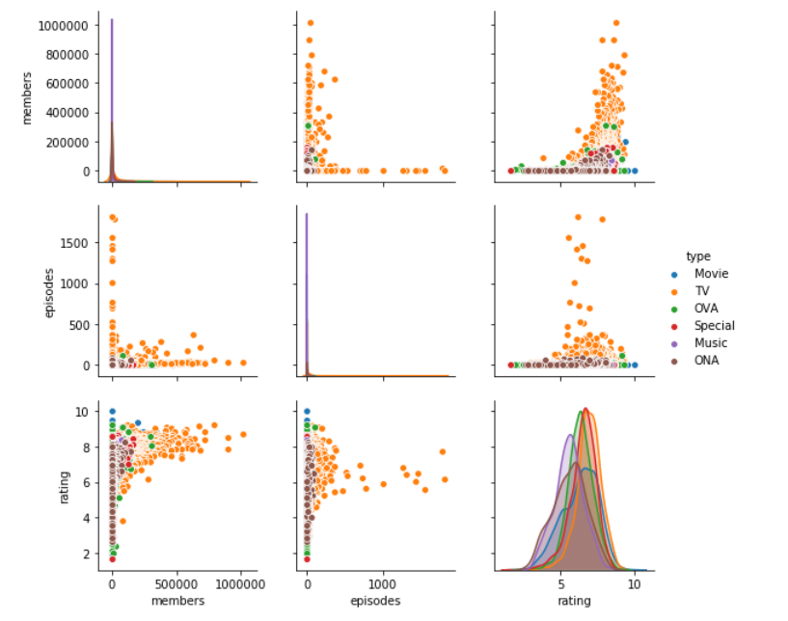
Methodolgy
3.1 Data Visualization
A pairplot can be very helpful in comparing many factors at a same time. Type was chosen as determining factors in these graphs and they are represented with various colors for better understanding.

Slide 6
3.2 Recommendation system
Recommendation systems try to capture patterns of similar behaviors, to help predict what else you might like based on similar users or previous information. Recommendation systems are usually at play on many websites. For example, suggesting books on Amazon and movies on Netflix. In fact, everything on Netflix’s website is driven by customer selection.
There are generally 2 main types of recommendation systems: Content-based and collaborative filtering.
The main difference between each, can be summed up by the type of statement that a consumer might make.
For instance, the main paradigm of a Content-based recommendation system is driven by the statement: “Show me more of the same of what I've liked before." Content-based systems try to figure out what a user's favorite aspects of an item are, and then make recommendations on items that share those aspects.

Slide 7
Collaborative Filtering
The first technique we're going to take a look at is called Collaborative Filtering, which is also known as User-User Filtering. As hinted by its alternate name, this technique uses other users to recommend items to the input user. It attempts to find users that have similar preferences and opinions as the input and then recommends items that they have liked to the input. There are several methods of finding similar users (Even some making use of Machine Learning), and the one we will be using here is going to be based on the Pearson Correlation Function.
The process for creating a User Based recommendation system is as follows:
Select a user with the movies the user has watched
Based on his rating to movies, find the top X neighbors
Get the watched movie record of the user for each neighbour.
Calculate a similarity score using some formula
Recommend the items with the highest score

Slide 8
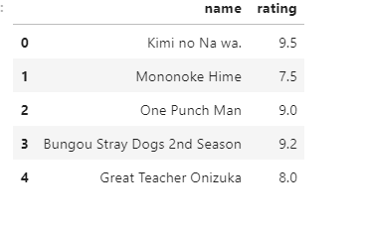
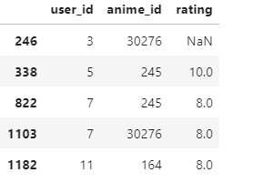
The process begin by creating or choosing a particular user preferences i.e, the anime series the particular user watched and reviewed.
With the input complete, let's extract the input anime ID's from the anime dataframe and add them into it.
We can achieve this by first filtering out the rows that contain the input movies' title and then merging the subset with the input dataframe. We also drop unnecessary columns for the input to save memory space.
The users who has seen the same movies.Now with the movie ID's in our input, we can now get the subset of users that have watched and reviewed the movies in our input.

Slide 9
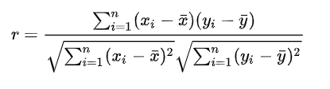
Pearson Coeffcient
Pearson correlation is invariant to scaling, i.e. multiplying all elements by a nonzero constant or adding any constant to all elements. For example, if you have two vectors X and Y,then, Pearson(X, Y) == Pearson(X, 2 * Y + 3). This is a pretty important property in recommendation systems because for example two users might rate two series of items totally different in terms of absolute rates, but they would be similar users (i.e. with similar ideas) with similar rates in various scales .
The values given by the formula vary from r = -1 to r = 1, where 1 forms a direct correlation between the two entities (it means a perfect positive correlation) and -1 forms a perfect negative correlation.

Slide 10
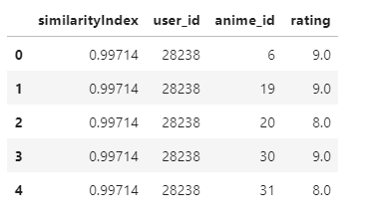
Now, let's start recommending movies to the input user.
Rating of selected users to all movies
We're going to do this by taking the weighted average of the ratings of the movies using the Pearson Correlation as the weight. But to do this, we first need to get the movies watched by the users in our pearsonDF from the ratings dataframe and then store their correlation in a new column called similarityIndex". This is achieved below by merging of these two tables.

Slide 11
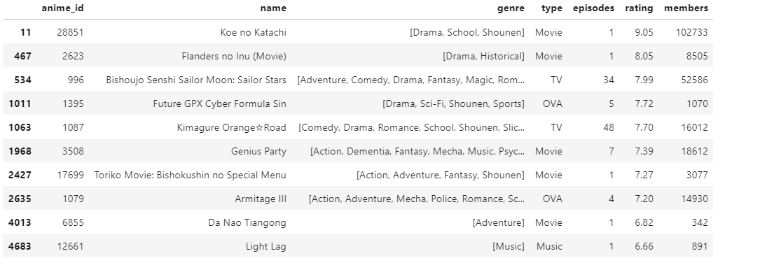
Result

Slide 12
Discussion
Though the process itself is not complicated but it miraculous how the recommendation system works despite containing such a large amount of dataset, though one thing was quite disappointing was that the input dataset in I used was anime that I watched and I was expecting something that I might have watched will be recommended in the recommendation system but it was not, so it is some what clear that recommendation system or collaborative filtering is always not the best option though we have many other types of recommendation systems.

Slide 13
Conclusion
In future the demand for recommend system is going to increase in tremendous rate since recommendations systems can be quite useful in time saving which we might waste while trying to find something to our interest. In order to search for interests for a single user we used a quite a large data set and we able to create a dataframe of the desired output.
REFERENCE:
https://www.kaggle.com/CooperUnion/anime-recommendations-database/kernels
https://www.kaggle.com/ajmichelutti/collaborative-filtering-on-anime-data
https://labs.cognitiveclass.ai/tools/jupyterlab/lab/tree/labs/coursera/ML0101EN/ML0101EN-Clus-DBSCN-weather-py-v1.ipynb

